Slide 1



Student Buddy
答辩人：王心怡

Slide 2
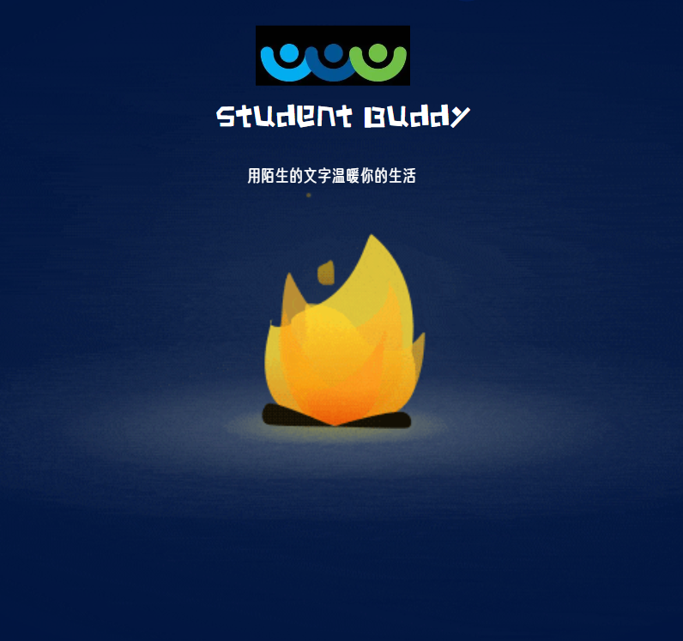
Catalog
1
Project background and significance
2
Design thought
3
Non-Functional Requirements
4
Group members work assignment

Slide 3

Part1
Project background and significance

Slide 4



Project background and significance
功能不全面
Increasing social demands of students
In modern university life, students are faced with increasingly busy academic pressure and social demands. They want to connect with classmates, share experiences and expand their social circle.
Diversified demands of student life
Project background
students face a variety of demands in campus life, such as finding people to buy, find people to pick up express delivery, and sell idle items. There is currently no application on the market that integrates these functions.
The popularity of mobile Internet
部分竞品在保护用户隐私和安全方面做得不够好，容易受到来自陌生人的骚扰和威胁。
With the popularity of smart phones and mobile Internet, students rely more on mobile applications to meet their various needs.

Slide 5

Project background and significance
Project Significance
Convenient social platform: Students can connect with other students, exchange information, and share experience and knowledge through the friend chat function.
Promote cooperation and mutual assistance among students: Through the provision of errand services, promote cooperation and mutual assistance among students, so that students can help each other solve various problems in life.
Provide a convenient second-hand trading platform: students can sell idle items here, buy other people's second-hand items, realize resource sharing and environmental protection concept.
Enhance students' social experience and skills: Students can actively participate in social activities, expand their social circle, and improve their social experience and skills.

Slide 6
Part2
Design Thought

Slide 7
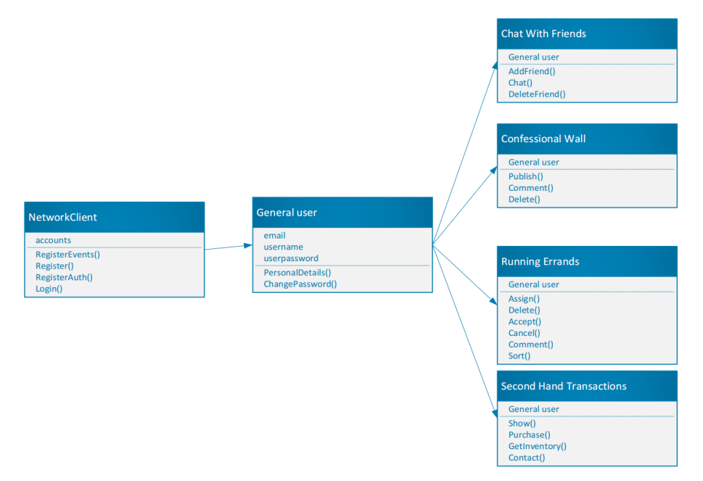
Class diagram

Slide 8
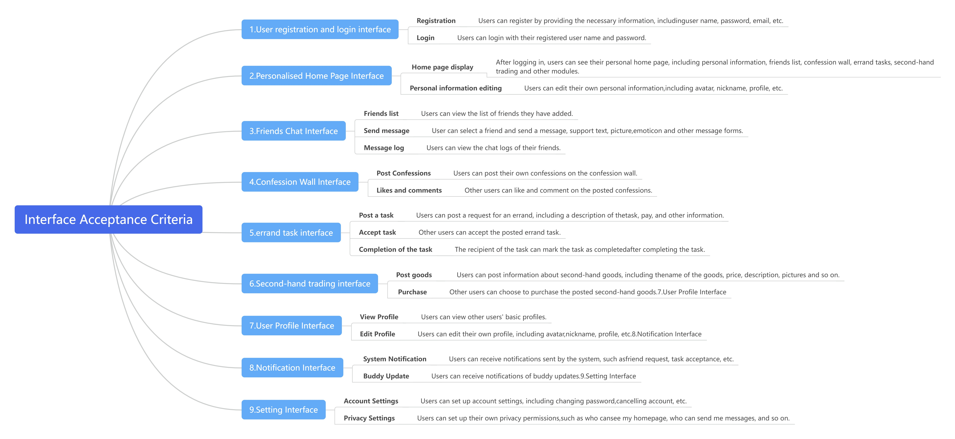
Design thought

Slide 9
Part3
Non-Functional Requirements

Slide 10




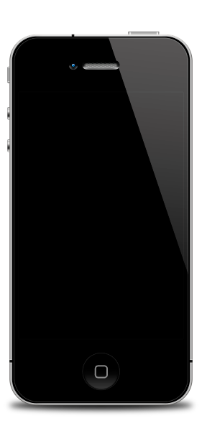

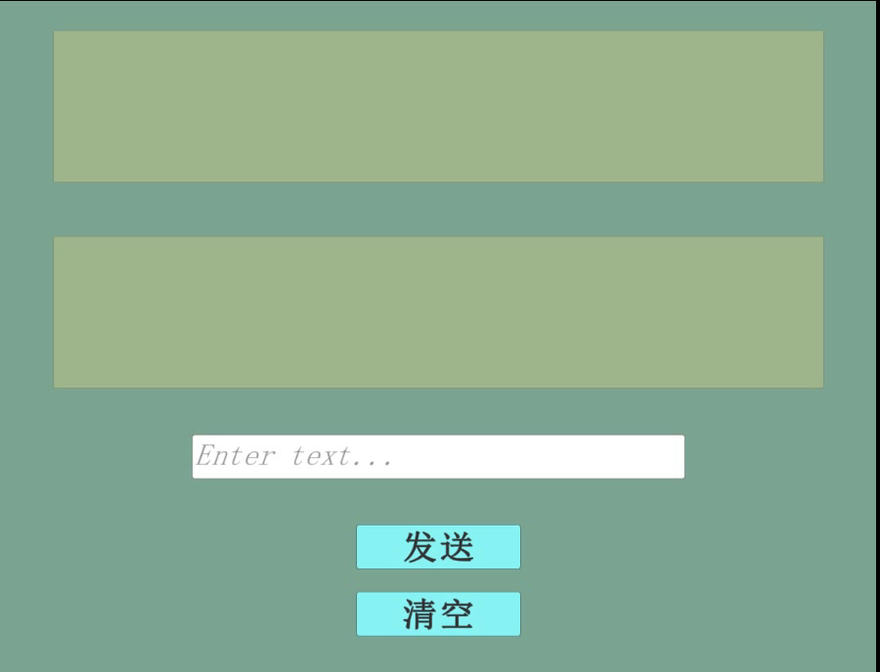

The non-functional requirements
1. Performance
The app provides a smooth, responsive user experience that minimises delays in messaging and interaction.Can support large numbers of concurrent users without performance degradation. Use connection pooling and asynchrony in MySql.
2. Security
securely stores user passwords using industry-standard encryption methods.detects sensitive words to prevent offensive content from appearing on anonymous confession walls and to avoid pornographic and illegal images. (Baidu)Protects user data from unauthorised access and handles data breaches in a timely manner.
3. Usability
The user interface should be intuitive, visually appealing, and easy to use.The application supports multiple languages to meet the needs of international students.

Slide 11
Part4
Group members work assignment

Slide 12
Group members work assignment
Student ID | Task Description | Contribution
832102208_21126917 | Blog essay | 8%
832102222_21125414 | Blog essay | 8%
832102209_21125309 | Rules and Format Check | 8%
832102210_21126909 | Demand analysis report PPT | 9%
832102228_21126895 | Demand analysis report PPT | 9%
832102204_21125929 | Demand Analysis Review Form | 9%
832102211_21124744 | Demand Analysis Review Form | 9%
832101201_21124477 | Collaboration and Division of Labor, Requirements Specification | 10%
832102218_21125261 | Requirements Specification | 10%
832102220_21126496 | Requirements Specification | 10%
832102223_21126348 | Requirements Specification | 10%

Slide 13
谢谢观看

